Slide 1
Non-Normal and Missing Data
Joshua F. Wiley joshua.wiley@monash.edu
http://bml.science

Slide 2
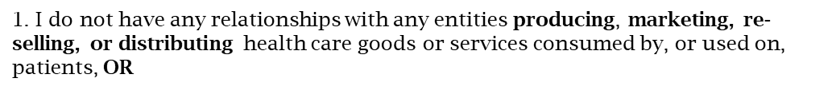
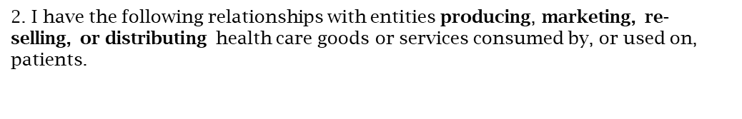
X
Type of Potential Conflict | Details of Potential Conflict
Grant/Research Support
Consultant
Speakers’ Bureaus
Financial support
Other

Slide 3
Introduction and Notes

Slide 4
Outline
Non-Normal Data
Examples
Why it is a problem
Bootstrapping as a solution
Bootstrapping for longitudinal data
Missing Data
Examples
Why it is a problem
Multiple Imputation (MI) as a solution
MI for longitudinal data

Slide 5
Software
I will use R to demonstrate. If you are new to R, you can see this guide with steps and information: http://joshuawiley.com/MonashHonoursStatistics/IntroR.html
You can download the raw R markdown code for this presentation here: http://joshuawiley.com/APSS2021_MissingData/MissingData.rmd

Slide 6
Packages
We will use several R packages today. You load packages with the library() function. If a package is not yet installed, you can install it using the install.packages() function.
options(digits = 3) ## reduce decimals in output ## some people have reported also needing the zip pkg # install.packages("zip") before the other packages install correctly library(data.table) ## data management library(boot) ## bootstrapping library(parallel) ## parallel processing library(JWileymisc) ## tools library(lme4) ## longitudinal models library(multilevelTools) ## convenient functions for multilevel models library(mice) ## multiple imputation library(VIM) ## visualize missing data library(ggplot2) ## general visualization

Slide 7
Dealing with Non-Normal Data

Slide 8
Non-Normal Data Examples
There are many kinds of non-normal variables
Some variables are not continuous, such as whether someone has OSA or not (yes/no), which is binary
Sleep also has many variables that have a continuous but non-normal distribution, such as Sleep Onset Latency (SOL)
data(aces_daily) ## load a daily sleep study dataset aces_daily <- as.data.table(aces_daily) aces_daily[, sqrtSOL := sqrt(SOLs)]

Slide 9
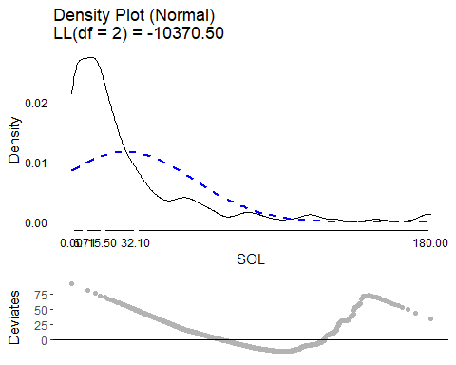
SOL Distribution
plot(testDistribution(aces_daily$SOLs), varlab = "SOL") ## plot distribution

Slide 10
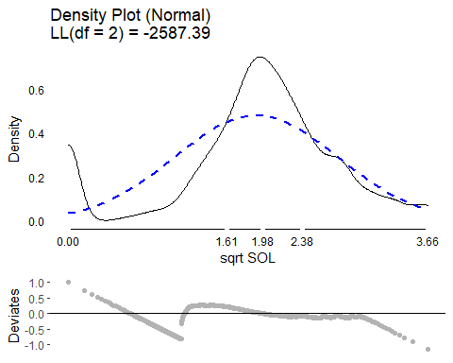
SOL Distribution - Square Root
plot(testDistribution(sqrt(aces_daily$sqrtSOL)), varlab = "sqrt SOL")

Slide 11
Why Non-Normal Data is a Problem
Normal inferential statistics (i.e., confidence intervals, standard errors, p-values) are wrong if the model assumes data are normally distributed and they are not.
duse <- aces_daily[!duplicated(UserID)] m <- lm(sqrtSOL ~ Age, data = duse)

Slide 12
Linear Regression Results
APAStyler(modelTest(m))[, -3]
Term | Est
(Intercept) | -3.02 [-20.46, 14.43]
Age | 0.40 [ -0.41, 1.21]
N (Observations) | 14
logLik DF | 3
logLik | -34.37
AIC | 74.74
BIC | 76.65
F2 | 0.10
R2 | 0.09
Adj R2 | 0.01
Age | f2 = 0.10, p = .300

Slide 13
Bootstrap Introduction
Parametric models make assumptions about the sampling distribution of parameters.
Bootstrapping empirically generates the sampling distribution of parameters by repeated sampling
Bootstrapping, at its most basic, involves sampling, with replacement, from a dataset, refitting the model, storing the parameter(s), and then repeating many times to build up an empirical distribution.

Slide 14
Bootstrap Conceptual Example
ID | V1 | V2 | V3 | V4
1 | 4 | 5 | 4 | 4
2 | 2 | 4 | 4 | 5
3 | 5 | 2 | 5 | 2
4 | 4 | 2 | 4 | 5
5 | 1 | 4 | 3 | 2

Slide 15
Bootstrap Introduction
Because bootstrapping involves empirically building up the sampling distribution for parameters, the more bootstrap samples, the more precise the estimates
The empirical distribution can then be summarized to calculate confidence intervals, the standard deviation of the bootstrap distribution is the standard error of the parameter
If possible, 10,000 + bootstrap samples ideal. Takes computational, but not researcher time

Slide 16
Bootstrapping Code Example
First we setup a local cluster using 10 CPU cores
We export the saved model, m, and datasets, duse and aces_daily
Use the boot() function to bootstrap the model and save the coefficients, with 20,000 bootstraps
cl <- makeCluster(10) clusterExport(cl, c("m", "duse", "aces_daily")) bootres <- boot(duse, function(x, i) { coef(update(m, data = duse[i, ])) }, R = 20000, parallel = "snow", ncpus = 10, cl = cl)

Slide 17
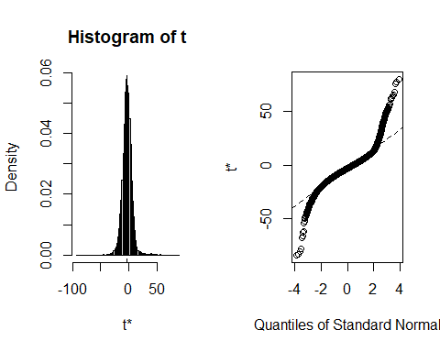
Bootstrapping Intercept Results 1
plot(bootres, index = 1)

Slide 18
Bootstrapping Intercept Results 2
coef(m)[1]
## (Intercept) ## -3.02
boot.ci(bootres, index = 1, type = "perc")
## BOOTSTRAP CONFIDENCE INTERVAL CALCULATIONS ## Based on 20000 bootstrap replicates ## CALL : ## boot.ci(boot.out = bootres, type = "perc", index = 1) ## Intervals : ## Level Percentile ## 95% (-19.7, 13.1 ) ## Calculations and Intervals on Original Scale

Slide 19
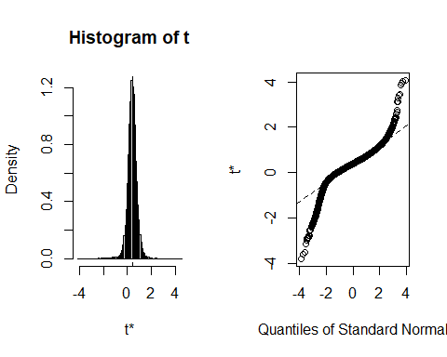
Bootstrapping Age Slope Results 1
plot(bootres, index = 2)

Slide 20
Bootstrapping Age Slope Results 2
coef(m)[2]
## Age ## 0.401
boot.ci(bootres, index = 2, type = "perc")
## BOOTSTRAP CONFIDENCE INTERVAL CALCULATIONS ## Based on 19998 bootstrap replicates ## CALL : ## boot.ci(boot.out = bootres, type = "perc", index = 2) ## Intervals : ## Level Percentile ## 95% (-0.38, 1.17 ) ## Calculations and Intervals on Original Scale

Slide 21
Bootstrapping Longitudinal Data
Beyond linear regression, bootstrapping can also be applied to other models, such as multilevel models for longitudinal data.
Bootstrapping multilevel models for longitudinal data can take a variety of forms, but the basic idea is the same.
Lai, M. H. (2020). Bootstrap confidence intervals for multilevel standardized effect size. Multivariate Behavioral Research, 1-21.
mlm <- lmer(sqrtSOL ~ STRESS + (1 | UserID), data = aces_daily, REML = FALSE)

Slide 22
Longitudinal Results
APAStyler(modelTest(mlm))[, -3]
Term | Est
(Intercept) | 4.27*** [ 3.96, 4.58]
STRESS | 0.03 [-0.02, 0.08]
sd_(Intercept)|UserID | 1.93
sigma | 2.10
Model DF | 4
N (Groups) | UserID (191)
N (Observations) | 1900
logLik | -4317.21
AIC | 8642.41
BIC | 8664.61
Marginal R2 | 0.00
Marginal F2 | 0.00
Conditional R2 | 0.46
Conditional F2 | 0.84
STRESS (Fixed) | 0.00/0.00, p = .223

Slide 23
Longitudinal Bootstrapped Results
APAStyler(modelTest(mlm, method = "boot", nsim = 1000, parallel = "snow", ncpus = 10, cl = cl))[, -3]
Term | Est
(Intercept) | 4.27*** [ 3.96, 4.60]
STRESS | 0.03 [-0.02, 0.08]
sd_(Intercept)|UserID | 1.93 [1.72, 2.14]
sigma | 2.10 [2.03, 2.17]
Model DF | 4
N (Groups) | UserID (191)
N (Observations) | 1900
logLik | -4317.21
AIC | 8642.41
BIC | 8664.61
Marginal R2 | 0.00
Marginal F2 | 0.00
Conditional R2 | 0.46
Conditional F2 | 0.84
STRESS (Fixed) | 0.00/0.00, p = .223

Slide 24
Further Reading
Efron, B., & Tibshirani, R. J. (1994). An introduction to the bootstrap. CRC press.
Davison, A. C., & Hinkley, D. V. (1997). Bootstrap methods and their application (No. 1). Cambridge university press.
Goldstein, H. (2011). Bootstrapping in multilevel models. Handbook of advanced multilevel analysis, 163-171.
Van der Leeden, R., Meijer, E., & Busing, F. M. (2008). Resampling multilevel models. In Handbook of multilevel analysis (pp. 401-433). Springer, New York, NY.
Lai, M. H. (2020). Bootstrap confidence intervals for multilevel standardized effect size. Multivariate Behavioral Research, 1-21.

Slide 25
Simple Tutorials
https://towardsdatascience.com/a-practical-guide-to-bootstrap-with-r-examples-bd975ec6dcea
https://cran.r-project.org/doc/Rnews/Rnews_2002-3.pdf

Slide 26
Missing Data: Multiple Imputation

Slide 27
Missing Data Background
Missing data are very common, but also problematic
Results from the non-missing data may be biased
Missing data cause a loss of efficiency
The easiest approach to “address” missing data is to only analyze complete cases (i.e., list-wise deletion). This often leads to inefficiency (e.g., discarding data on X and Z because observation on variable Y are missing). Also, list wise deletion may bias results unless the data are missing completely at random (MCAR).

Slide 28
Missing data classifications
Missing completely at random (MCAR) when the missingness mechanism is completely independent of the estimate of our parameter(s) of interest.
Missing at random (MAR) when the missingness mechanism is conditionally independent of the estimate of our parameter(s) of interest
Missing not at random (MNAR) when the missingness mechanism is associated with the estimate of our parameter(s) of interest

Slide 29
Missing Data Background
Our parameters may be anything, such as a mean, a standard deviation, a regression coefficient, etc. We will explore multiple imputation (MI) as one robust way to address missing data.

Slide 30
Multiple Imputation (MI) Theory
Multiple imputation is one robust way to address missing data. It involves generate multiple, different datasets where in each one, different, plausible values are imputed for the missing data, resulting in each imputed dataset have “complete” data since missing data are filled in by predictions.

Slide 31
Multiple Imputation Steps
The general process to generate multiply imputed using a robust approach: fully conditional specification (FCS) or multiple imputation through chained equations (mice) is:
Start with a raw dataset with missing data
Fill in the missing data values with initial estimates. *The first “fill in” estimates are generally fast and easy to generate (e.g., using median)
For each variable that has missing data, build a prediction model from other variables. often, all other variables in the dataset being imputed are used, e.g., in a GLM in the prediction model
Use the model to predict the missing data.
Repeat steps 2 and 3 until the change from on iteration to another is small (indicating convergence)

Slide 32
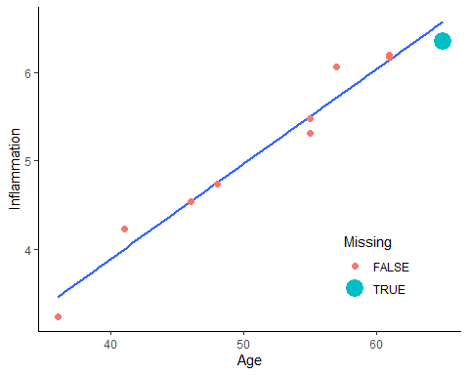
Imputation Example
These steps may be easier to understand with a concrete example. Here we simulate a small dataset with age and inflammation.

Slide 34
Imputation Convergence Results
We can print out the imputed values too and see how those change. This highlights how over iterations, there are big changes at first, and with more iterations the changes are smaller and smaller. This is what is meant by convergence where you converge to a final, stable value.
print(imps, digits = 5)
## [1] 5.3161 6.2708 6.5526 6.6358 6.6603 6.6676 6.6697 6.6703 6.6705 6.6706

Slide 35
Multiple Imputation Background
The final step in multiple imputation, is that rather than generating a single best imputed value for missing values, we generate multiple values, creating many different complete datasets, each with different plausible values. Analyses are performed on each dataset, and then the results of all the analyses are pooled or combined together, capturing uncertainty within each dataset (due to sampling variation) and uncertainty across datasets (due to missing data variation).

Slide 36
MI in R
Before we can try MI in R we need to make a dataset with missing values. It is possible to do multilevel imputation, but it is more complicated and outside the scope of this workshop. Longitudinal imputation if you have a few discrete time points can be done by using wide data, so that each row is independent.
For the sake of example, we will take only complete data and then add missing data ourselves. This allows us to compare different approaches with the “truth” from the non-missing data.
The code below is not important to understand. It just creates three datasets:
The raw daily diary dataset we’ve worked with
A complete case, between person dataset with no missing values.
A between person dataset with missing values

Slide 37
MI in R Dataset Code
## between person data, no missing davg <- na.omit(aces_daily[, .( Female = factor(na.omit(Female)[1], levels = 0:1), Age = na.omit(Age)[1], STRESS = mean(STRESS, na.rm = TRUE), PosAff = mean(PosAff, na.rm = TRUE), NegAff = mean(NegAff, na.rm = TRUE)), by = UserID]) ## create missing data davgmiss <- copy(davg) davgmiss[STRESS < 1, NegAff := NA] davgmiss[STRESS > 4, PosAff := NA] ## random missingness on age and Female set.seed(1234) davgmiss[rbinom(.N, size = 1, prob = .1) == 1, Age := NA_real_] davgmiss[rbinom(.N, size = 1, prob = .05) == 1, Female := NA] ## drop unneeded variables to make analysis easier davgmiss[, UserID := NULL]

Slide 38
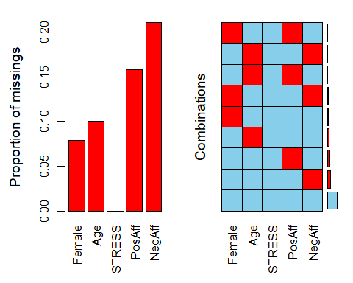
First Steps
Before imputation, we should examine our data. The VIM package in R has helpful functions for this. aggr(davgmiss, prop = TRUE, numbers = TRUE)
Notes:
We start by looking at the amount missing on each variable and the patterns of missing data using the aggr() function. This shows us that just over half of cases have complete data on all variables.
The left hand side of this missing data plot shows the proportion of missing data on each individual variable. Variables where the bars have no height are variables with no (or very nearly no) missing data. Variables with higher bars have a greater proportion of missing observations on that variable. The right hand side shows different patterns of missing data. Blue indicates present data. Red indicates missing data.

Slide 39
First Steps
A margin plot is an augmented scatter plot that in the margins shows the values on one variable when missing on the other along with a boxplot. This shows us that when negative affect is missing, stress scores are all low between 0 and 1. There are no missing stress scores so there is only one boxplot for negative affect.
The margin plot starts with a scatter plot. Blue dots are observed data. Red dots are imputed data.
marginplot(davgmiss[,.(STRESS, NegAff)])

Slide 40
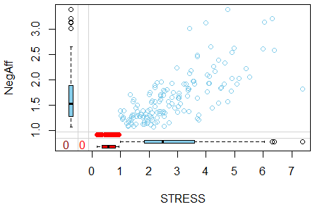

Slide 41
First Steps
We can test whether levels of one variable differ by missing on another variable. This is often done with simple analyses, like t-tests or chi-square tests.
## does stress differ by missing on negative affect? t.test(STRESS ~ is.na(NegAff), data = davgmiss)
## Welch Two Sample t-test ## data: STRESS by is.na(NegAff) ## t = 20, df = 178, p-value <2e-16 ## alternative hypothesis: true difference in means is not equal to 0 ## 95 percent confidence interval: ## 2.02 2.47 ## sample estimates: ## mean in group FALSE mean in group TRUE ## 2.827 0.581
## does sex differ by missing negative affect? chisq.test(davgmiss$Female, is.na(davgmiss$NegAff))
## ## Pearson's Chi-squared test with Yates' continuity correction ## ## data: davgmiss$Female and is.na(davgmiss$NegAff) ## X-squared = 0.5, df = 1, p-value = 0.5

Slide 42
MI in R
Conducting MI in R is relatively straight forward. A very flexible, robust approach is available using the mice package and the mice() function. You can control almost every aspect of the MI in mice() but you also can use defaults.
mice() takes a dataset, the number of imputed datasets to generate, the number of iterations, the random seed (make it reproducible) and default imputation methods. The defaults are fine, but you can change default imputation methods.

Slide 43
MI in R
Below we ask for all GLMs as imputation methods
“norm” which is linear regression for numeric data
“logreg” which is logistic regression for factor data with 2 levels
“polyreg” which is polytomous or multinomial regression for unordered factor data with 3+ levels
“polr” ordered logistic regression for factor data with 3+ ordered levels
R will do the steps discussed to then generate imputed datasets. We plot them to see if there is evidence of convergence. We set the maximum iterations as 20.
mi.1 <- mice( davgmiss, m = 5, maxit = 20, defaultMethod = c("norm", "logreg", "polyreg", "polr"), seed = 1234, printFlag = FALSE)

Slide 44
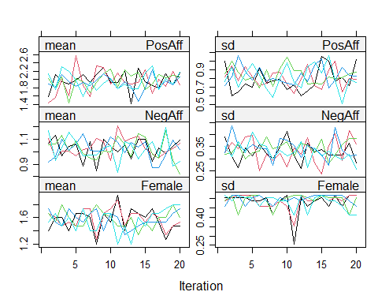
MI in R Convergence
plot(mi.1, PosAff + NegAff + Female ~ .it | .ms)

Slide 45
MI Diagnostics
Diagnostic plots do not necessarily tell you whether the imputation is “right” or “wrong”. They show in blue the observed density plots and in blue the observed data scatter plots. The red lines and points represent the distributions from the imputed data.
densityplot(mi.1, ~ PosAff + NegAff + Age)

Slide 46
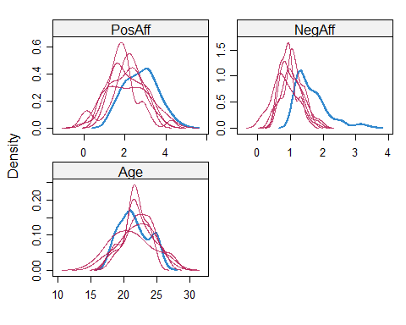

Slide 47
MI in R
Once you have created the imputed datasets, you can analyse them. Analyses must be repeated on each individual dataset. For models that are fitted with a formula interface, you can use the special with() function which works with multiply imputed datasets. It means that the analysis is automatically run on each imputed dataset separately. To pool the results from the individual regressions, we use the pool() function.

Slide 48
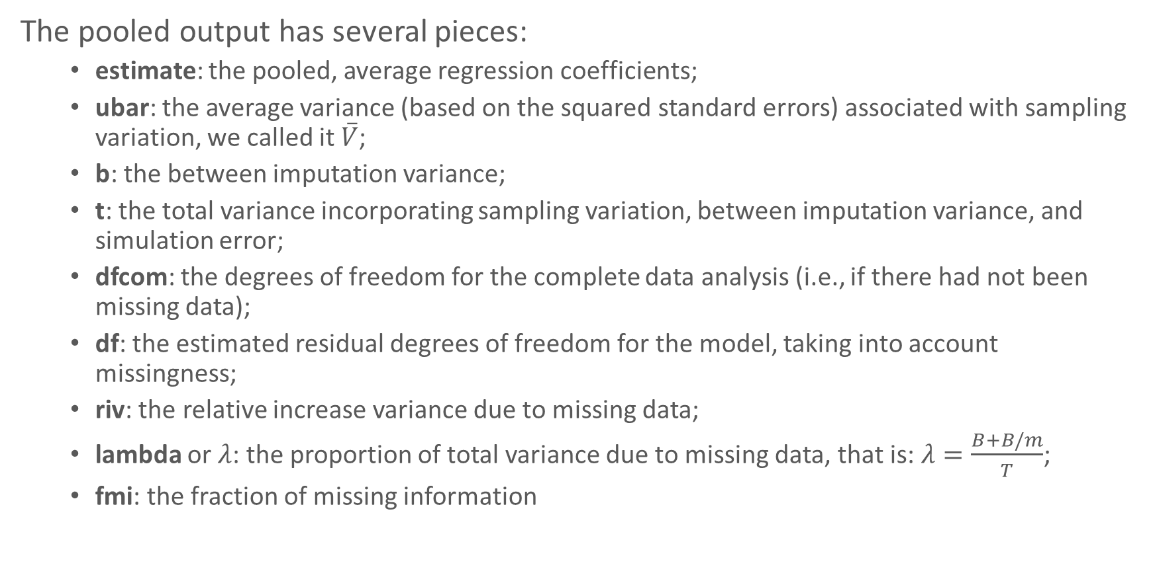
MI Pooled Results in R
The pooled output has several pieces:
estimate: the pooled, average regression coefficients;
ubar: the average variance (based on the squared standard errors) associated with sampling variation, we called it $\overset{‾}{V}$;
b: the between imputation variance;
t: the total variance incorporating sampling variation, between imputation variance, and simulation error;
dfcom: the degrees of freedom for the complete data analysis (i.e., if there had not been missing data);
df: the estimated residual degrees of freedom for the model, taking into account missingness;
riv: the relative increase variance due to missing data;
lambda or $λ$: the proportion of total variance due to missing data, that is: $λ=\frac{B+B/m}{T}$;
fmi: the fraction of missing information

Slide 49
MI Pooled Results in R
mi.reg <- with(mi.1, lm(NegAff ~ PosAff + Age)) pool(mi.reg)
## Class: mipo m = 5 ## term m estimate ubar b t dfcom df riv lambda ## 1 (Intercept) 5 2.8622 0.125938 0.087402 0.230820 187 16.25 0.833 0.454 ## 2 PosAff 5 -0.2262 0.001661 0.003040 0.005308 187 7.39 2.196 0.687 ## 3 Age 5 -0.0349 0.000239 0.000114 0.000376 187 24.00 0.573 0.364 ## fmi ## 1 0.511 ## 2 0.747 ## 3 0.411

Slide 50
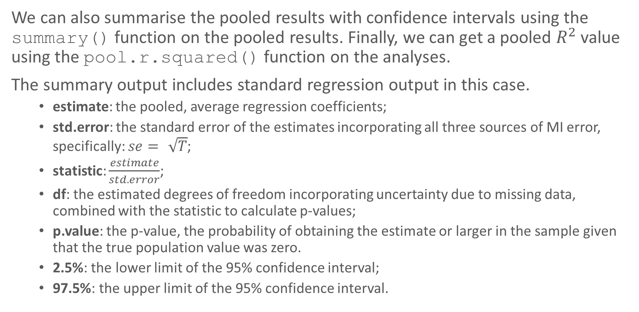
MI Pooled Results in R
We can also summarise the pooled results with confidence intervals using the summary() function on the pooled results. Finally, we can get a pooled $R^{2}$ value using the pool.r.squared() function on the analyses.
The summary output includes standard regression output in this case.
estimate: the pooled, average regression coefficients;
std.error: the standard error of the estimates incorporating all three sources of MI error, specifically: $se=\sqrt{T}$;
statistic: $\frac{estimate}{std.error}$;
df: the estimated degrees of freedom incorporating uncertainty due to missing data, combined with the statistic to calculate p-values;
p.value: the p-value, the probability of obtaining the estimate or larger in the sample given that the true population value was zero.
2.5%: the lower limit of the 95% confidence interval;
97.5%: the upper limit of the 95% confidence interval.

Slide 51
MI Pooled Results in R
m.mireg <- summary(pool(mi.reg), conf.int=TRUE) print(m.mireg)
## term estimate std.error statistic df p.value 2.5 % 97.5 % ## 1 (Intercept) 2.8622 0.4804 5.96 16.25 1.88e-05 1.845 3.87936 ## 2 PosAff -0.2262 0.0729 -3.10 7.39 1.61e-02 -0.397 -0.05573 ## 3 Age -0.0349 0.0194 -1.80 24.00 8.41e-02 -0.075 0.00508
pool.r.squared(mi.reg)
## est lo 95 hi 95 fmi ## R^2 0.161 0.0376 0.329 NaN

Slide 52
MI in R
In general, you can use any analysis you want with multiple imputation, replacing lm() with another function, including glm() and lmer().
Here is an example looking at a logistic regression (albeit a rather silly one) predicting Female from negative affect and age. We can select the coefficients and confidence intervals and exponentiate them to get the odds ratios.
mi.reg2 <- with(mi.1, glm(Female ~ NegAff + Age, family = binomial())) m.mireg2 <- summary(pool(mi.reg2), conf.int=TRUE) print(m.mireg2)
## term estimate std.error statistic df p.value 2.5 % 97.5 % ## 1 (Intercept) 1.1830 1.7840 0.663 54 0.510 -2.394 4.760 ## 2 NegAff -0.0678 0.3009 -0.225 135 0.822 -0.663 0.527 ## 3 Age -0.0308 0.0755 -0.408 53 0.685 -0.182 0.121
## odds ratios exp(m.mireg2[, c("estimate", "2.5 %", "97.5 %")])
## estimate 2.5 % 97.5 % ## 1 3.264 0.0913 116.70 ## 2 0.934 0.5154 1.69 ## 3 0.970 0.8334 1.13

Slide 53
Multiple Imputation Comparison
One thing that often is helpful is to compare results under different models or assumptions. Here we fit the same model in three ways:
pooled from the multiple imputations that was already done, labelled “MI Reg”.
based on the true, non-missing data, since we made the missing data ourselves and have the true data, labelled, “Truth”.
Complete case analysis using listwise deletion, labelled “CC”.

Slide 54
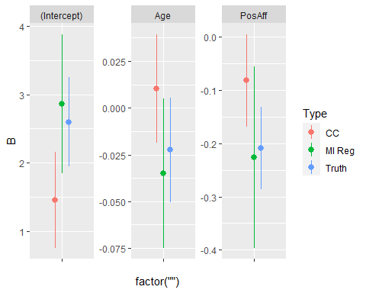

Slide 55
Function Summary
aggr() Create a plot of missingness by variable and patterns of mising data for an entire dataset
marginplot() Create a scatter plot of the non missing data between two continuous variables with the margins showing where missing data are
mice() Main worker function for multiple imputation through chained equations in R. Takes a dataset, the number of imputations and number of iterations as a minimum.
with() Function used to run models with a multiply imputed dataset.
pool() Pool / aggregate results run on multiply imputed data.
pool.r.squared() Calculate pooled $R^{2}$ value (only for lm() models) in multiply imputed analyses.

Slide 56
Further Reading
https://stefvanbuuren.name/fimd/ (Van Buuren, S. (2018). Flexible imputation of missing data. CRC press.)
Van Buuren, S. & Groothuis-Oudshoorn, K. (2010). mice: Multivariate imputation by chained equations in R. Journal of statistical software, 1-68.
Schafer, J. L. (1999). Multiple imputation: a primer. Statistical methods in medical research, 8(1), 3-15.
Schafer, J. L., & Graham, J. W. (2002). Missing data: our view of the state of the art. Psychological methods, 7(2), 147.
Enders, C. K. (2010). Applied missing data analysis. Guilford press.

Slide 57
Simple Tutorials
https://amices.org/mice/index.html
https://datascienceplus.com/imputing-missing-data-with-r-mice-package/

Slide 58
Thanks
Questions? (joshua.wiley@monash.edu)
Download all underlying codes here: http://joshuawiley.com/APSS2021_MissingData/MissingData.rmd
See a more beautiful web version with extra explanation and code here: http://joshuawiley.com/MonashHonoursStatistics/MissingData.html

